Slide 1

CHARACTERISTIC ANALYSIS OF UTB AND NW MODELS OF TFET FOR LOW POWER APPLICATIONS
( Major Project Stage - 2)
By
T. Praveenya (20WH1A0477)
B. Akshaya (20WH1A0479)
V. Leena (20WH1A0489)
K. Sneha (20WH1A04B5)
Under the Guidance of
Dr. M. Parvathi,
Professor , ECE Dept.
BVRIT HYDERABAD
College of Engineering For Women
Department of Electronics and Communication Engineering

Slide 2
Abstract
PROBLEM STATEMENT:
TFETs are widely preferred due to their least SS, less leakage current (I OFF) and low threshold voltage. The existing characteristic models from the literature on Tunnel Field-Effect Transistors (TFETs) have limited ranges of parameters like ON-state current, subthreshold swing (SS), and minimized power consumption for efficient low-power applications. Challenge lies in identifying the optimized TFET performance, overcoming existing design limitations, particularly in conventional and non-isolated heterojunction TFETs.
EXISTING SCENARIO:
The existing solutions are represented by conventional transistors and TFETs without an isolated heterojunction. These solutions, while functional, demonstrate limitations in achieving optimal ON-state current and subthreshold swing (SS) necessary for efficient low-power applications
. These existing TFET designs fall short in meeting the desired performance criteria, prompting the need for innovative approaches to improve their electrical characteristics.

Slide 3
PROPOSED STUDY AND ANALYSIS METHOD:
The proposed study method is done by considering the design and simulation of Heterojunction Tunnel Field-Effect Transistors (TFETs) with parameter such as channel length, channel thickness, oxide thickness, doping level.
The proposed study carried out on two models of TFET architectures taking into consideration and are Ultra-Thin Body (UTB) and Nanowire (NW) design methods.
These methods offer a range of distinct advantages crucial for achieving superior TFET performance in low power applications.
Identifying the typical operating values by observing the characteristics of Tunnel Field Effect Transistors through the graphs of I_{ds} v/s V_{gs} and to observe the model that results with suitable for low power applications.
Design and develop TFET based inverter cell using observed operating value.

Slide 4
Device Characteristics of UTB TFET

Slide 6
Device Parameters
Parameters | Values
Channel length(nm) | 40
Channel thickness(nm) | 4
Oxide thickness(nm) | 3
Source doping(cm^-3) | 1e20
Drain doping (cm^-3) | 5e10
Channel doping (cm^-3) | 1e15
Work Function | 4.45

Slide 7
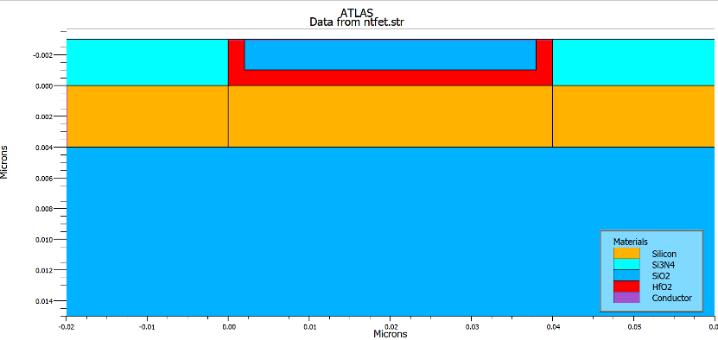
Structure Of UTBTFET

Slide 8
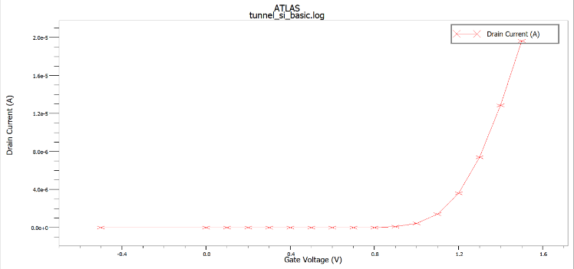
Ids VS Vgs graph

Slide 9
Device Performance Parameters
UTB Tunnel FET device | Values
Threshold voltage(Vt) | 0.709V
Sub threshold swing (SS) | 62 mV/dec
Max Ids | 2.53e-13

Slide 10
Device Characteristics of NWTFET

Slide 12
Device Parameters
Parameters | Values
Channel length(nm) | 100
Channel thickness(nm) | 10
Oxide thickness(nm) | 2
Source doping(cm^-3) | 1e20
Drain doping (cm^-3) | 2e20
Channel doping (cm^-3) | 1e16
Work Function | 4.8

Slide 13
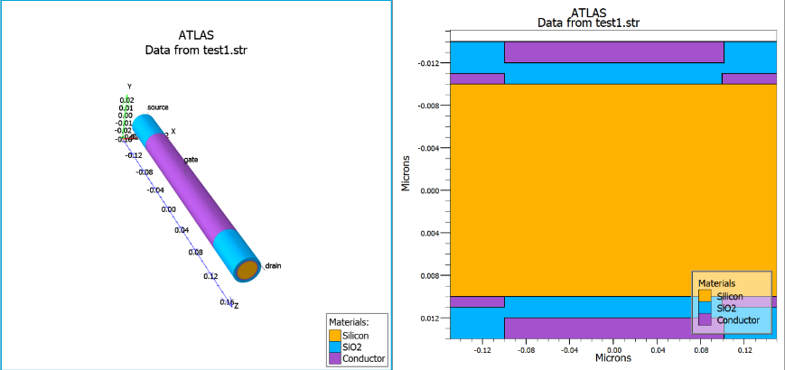
Structure Of NWTFET

Slide 14
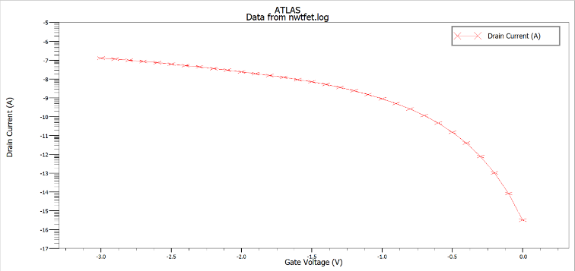
Ids VS Vgs graph

Slide 15
Device Performance Parameters
Tunnel FET device | Values
Threshold voltage(Vt) | 2.0958V
Sub threshold swing (SS) | 62 mV/dec
Max Ids | 1.2727e-07

Slide 16
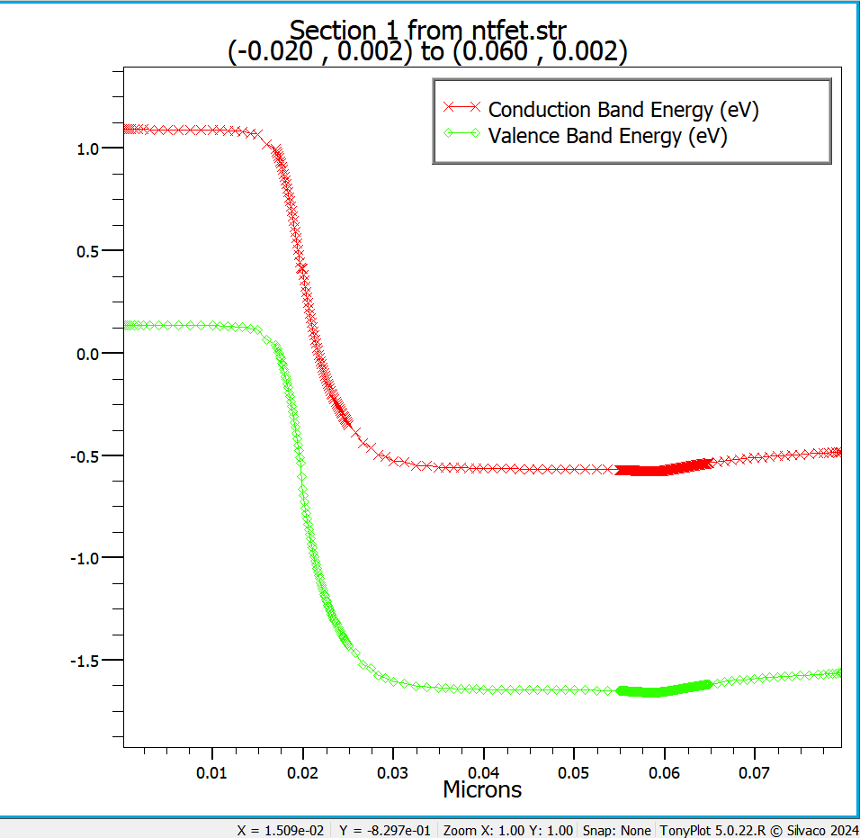
Energy Band graph

Slide 17
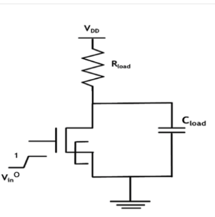
Inverter Circuit

Slide 18
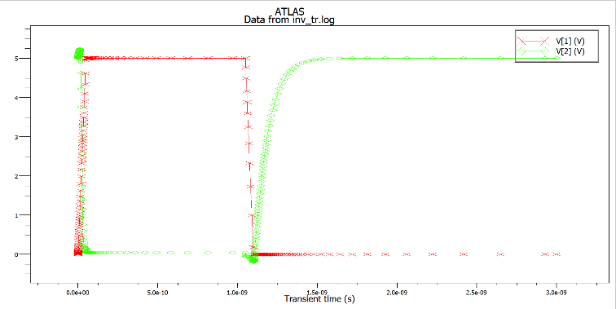
Inverter Output

Slide 19
References
M. L. Naidu, M. V. Patnaik, S. K. Sinha, S. Chander and R. Chaudhary, "NCTFET Device for Low Power VLSI Application," 2023 International Conference on Sustainable Computing and Smart Systems (ICSCSS), Coimbatore, India, 2023, pp. 1127-1132, doi: 10.1109/ICSCSS57650.2023.10169217.
Chander, Sweta & Sinha, Sanjeet & Singh, Prince & Singh, Ashish Kumar. (2021). “Design of Heterojunction Tunnel Field-Effect Transistors with SiO2 isolation between Source and Drain for Low Power Application.” 10.21203/rs.3.rs-668005/v1, preprint, Research Square.
Mondol, Kalyan et al. “Quantization, gate dielectric and channel length effect in double-gate tunnel field-effect transistor.” Results in Physics (2022): n. pag.
Walia, Akshit et al. “Impact of Temperature on the Performance of Tunnel Field Effect Transistor.” (2021).
Dutta, Umesh & Soni, M & Pattanaik, Manisha. (2018). “Design and Analysis of Tunnel FET for Low Power High Performance Applications.” International Journal of Modern Education and Computer Science. 10. 10.5815/ijmecs.2018.01.07.

Slide 20


Slide 21


